Slide 1
Abstract and learning objectives
Abstract
This whiteboard design session will guide us through designing an end-to-end solution for e-commerce that is based on Azure App Services, Azure Active Directory, and Azure Serverless. We must ensure the solution is PCI-compliant, and that appropriate security measures are put into place for both on-premises and public access scenarios.
Learning objectives
Deploying and configuring Azure Web Apps
Configuring web apps for authentication with Azure AD and Azure AD B2C
Instrumenting and load-testing applications with App Insights
Automating back-end services using Azure Functions and Logic Apps
Notes:
This is an introduction to the Cloud Workshop at a high level. Later we’ll get into customer objections, requirements, etc… but we want to ground the participants on the business outcomes we’re going after for the day.

Slide 2
Welcome! Integration with Azure
Speakers

Slide 3
Welcome to Country
We acknowledge the traditional custodians of the land and their continuing connection to our community. We pay respect to them, their culture and to their elders past and present.

Slide 4
Wi-Fi Access
Wi-Fi SSID:
MSFTGUEST
Event Attendee Code:
??

Slide 5
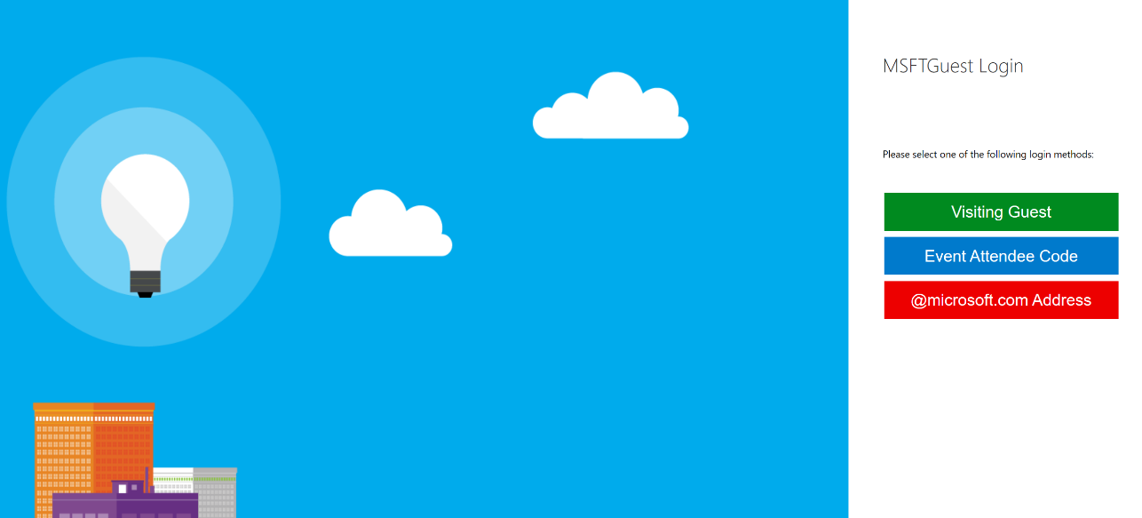
Setting up Wi-Fi Access
Connect to MSFTGUEST Wi-Fi network
A browser window should pop-up with further instructions. If the window does not appear, open a browser window and navigate to the following URL: https://msftguestap.partners.extranet.microsoft.com/guest/msfteventlogin.php?browser=1
Click on Event Attendee Code

Slide 6
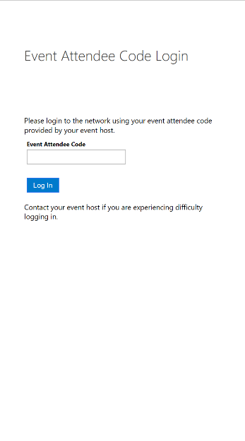
Setting up Wi-Fi Access
Enter the Event Attendee Code
Event Attendee Code:
msevent760tv

Slide 7
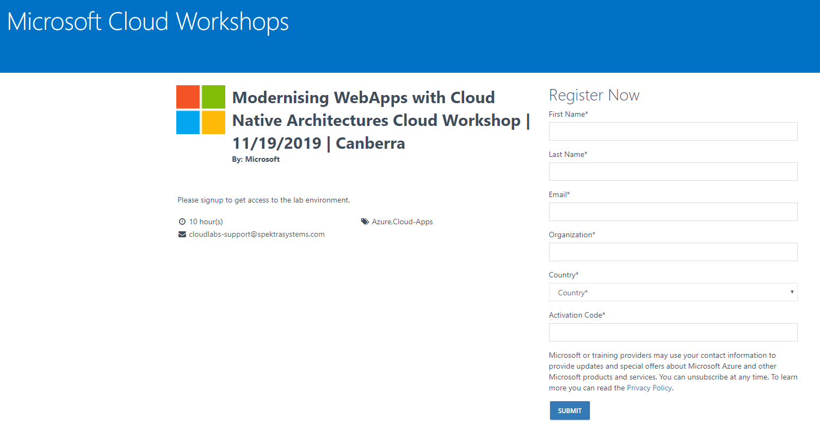
Lab Access
Lab Link:
http://bit.ly/2PCgAHC
Activation Code:
ACTIVATE4666

Slide 8
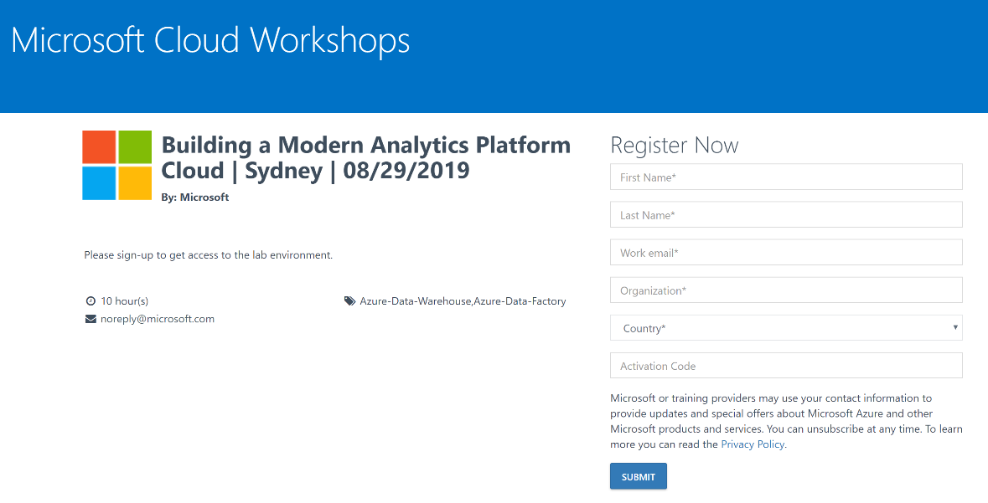
Lab Access
Open a browser window and navigate to the environment sign-up page on the link provided
Enter your details and type in the Activation Code provided
Click Submit
Environment Sign-Up Link:
http://bit.ly/2PCgAHC
Activation Code:
ACTIVATE4666

Slide 9
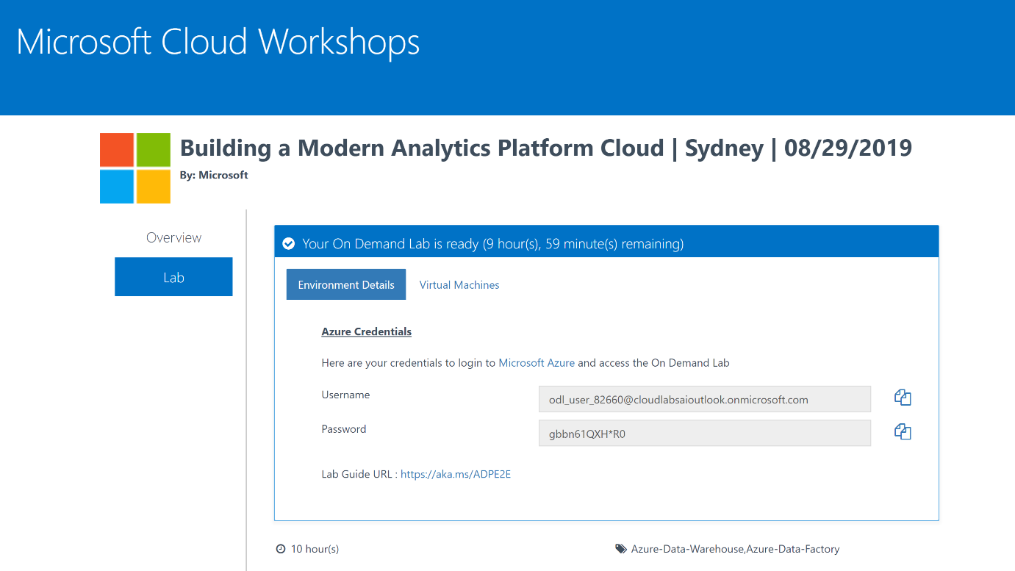
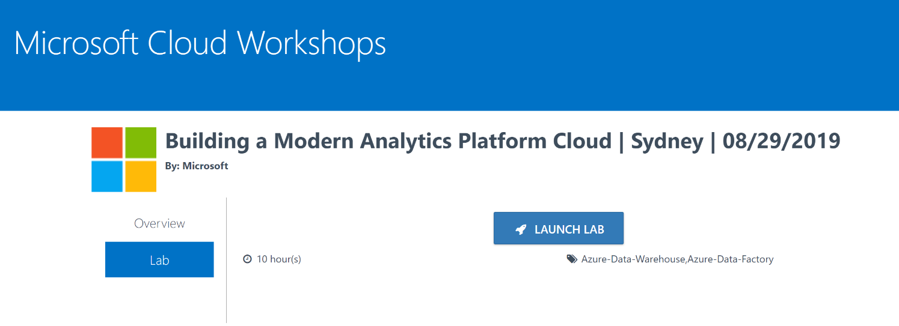
Lab Access
Click LAUNCH LAB
The Environment Details window will appear. Use the Username and Password in this window to access the Azure Portal.
Azure Portal:
https://portal.azure.com/
Lab Guide:
https://aka.ms/MCWMCA

Slide 10
Event Housekeeping
Please turn your phones to silent
Bathrooms are located down the hall
Food is provided for Morning Tea, Lunch, Afternoon Tea (Dietary requirements have been catered for, please respect the needs of these people)
Please be mindful that you are in an office environment and respect those who are working nearby
Please do not enter any meeting rooms other than the event room

Slide 11
Agenda
 | Duration | Start Time | End Time
Workshop Overview | 15 | 9:00 am | 9:15 am
Reviewing the case study | 15 | 9:15 am | 9:30 am
Solution Design + Chalk talks | 45 | 9:30 am | 10:15 am
Morning Tea Break | 15 | 10:15 am | 10:30 am
Solution design cont. | 90 | 10:30 am | 12:00 am
Preferred Solution walk through and debrief | 30 | 12:00 am | 12:30 am
Lunch | 30 | 12:30 pm | 1:00 pm
Case study design | 30 | 1:00 pm | 1:30 pm
Case study solution design | 75 | 1:15 pm | 2:30 pm
Afternoon Tea Break | 15 | 2:30 pm | 2:45 pm
Case study solution design cont. | 60 | 2:45 pm | 3:45 pm
Summarize etc. | 15 | 3:45 pm | 4:00 pm

Slide 12

Abstract and learning objectives
In this whiteboard design session, you work with a group to design a solution for integrating different services by leveraging Azure solutions. As part of the modernization effort, application enhancements are added using a mix of cloud and on-prem services.
At the end of this whiteboard design session, your ability to design an integration strategy for organizations looking to modernize on the cloud will be improved.

Slide 13
Before we begin…
What is ‘integration’?
What tools are available?

Slide 14
Integration…
Solves a set of common problems:
Stuff needs to be connected
The internet isn’t reliable
Applications are different in what they ask/tell

Slide 15
Integration contains…
Entities:
Messages
Events
Connectors
Routers
‘Bus’
ETL
APIs
Contracts
Etc.

Slide 16
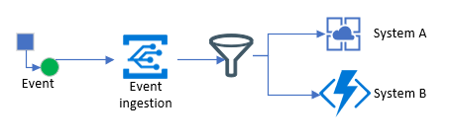
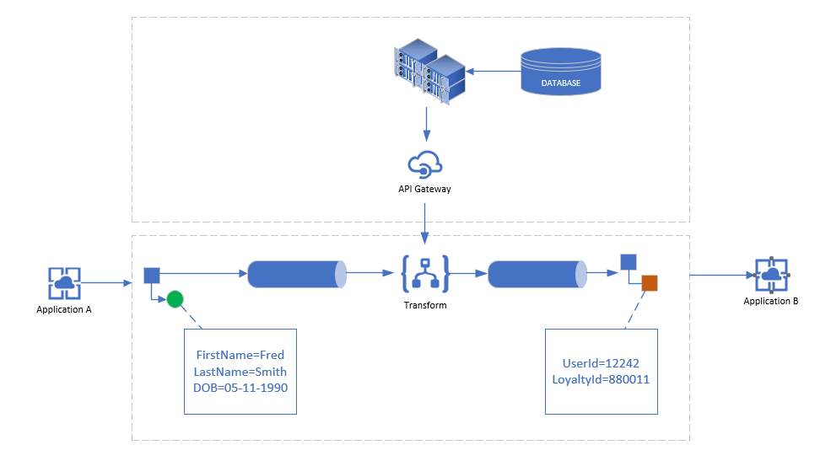
Integration is…a series of patterns
Patterns are modular, discreet solutions which are composed of ‘entities’ and fit together, like Lego

Slide 17
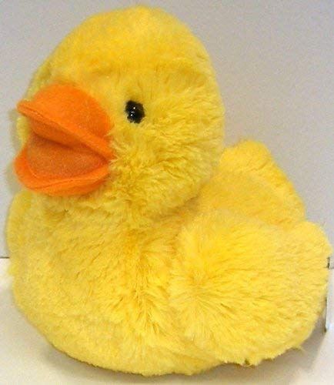
Customer situation
Fluffy Ducks. Co large multi-national organization, which sells plush ducks.
Technology has grown over time due to acquisitions etc.
Have run into several issues with current integration design, and it looking to modernize
“Quack McJefferson” CIO of Fluffy Ducks co. (could possibly be an actual duck) has engaged you to provide a solution

Slide 18
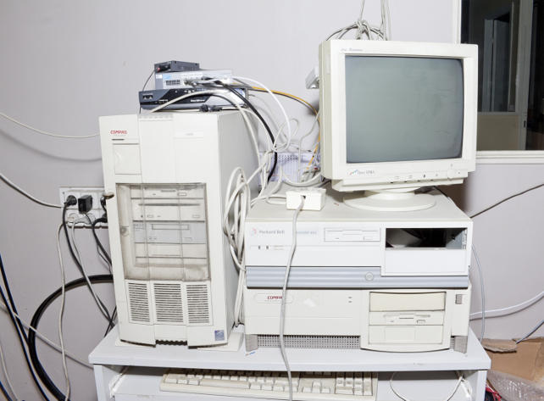
Customer situation
Looking to replace BizTalk, and looking to replace on-prem EOL hardware
Current integration solution doesn’t scale
Integrates with dynamics-365 and a 3rd-party provider
Business has appetite for innovation and redesign of current architecture

Slide 19

Customer needs
Move infrastructure and BizTalk to iPaaS solutions
Ensure local developers aren’t running SSIS packages locally
Migrate most payroll functions to PaaS
Provide a better experience when working with partner organizations (onboarding, data and API exchange, documentation)

Slide 20



Customer objections
How can the system automatically sync and trigger off of events happening?
Can solution provide a seamless partner integration experience for onboarding etc?
Can we secure the platform with an identity platform, such as Azure AD?

Slide 21
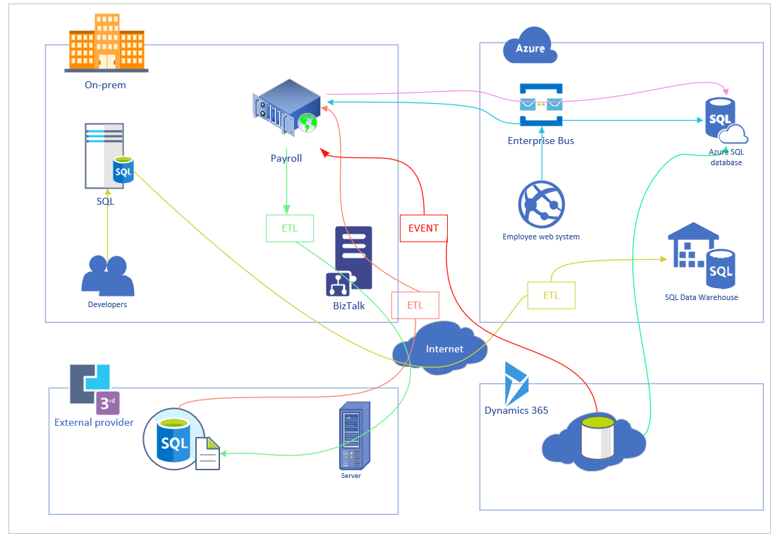
High-level requirements
aka.ms/mcw-integration-casestudy

Slide 22
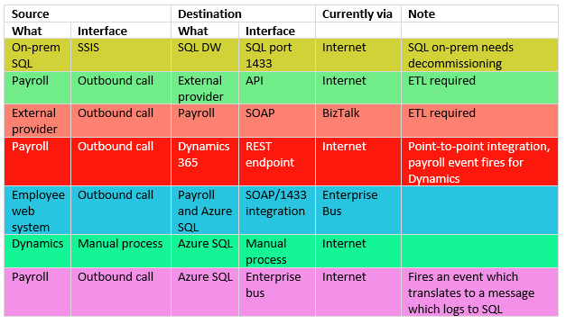
High-level requirements cont.
aka.ms/mcw-integration-casestudy

Slide 23
Step 1: Review the customer case study
Go to:
aka.ms/mcw-integration-casestudy
Outcome
Analyze your customer needs.
Timeframe
15 mins

Slide 24
Step 2: Design the solution
Outcome
Design a solution and prepare to present the solution to the target customer audience in a 15-minute chalk-talk format.
Timeframe
~1.5 hours total
aka.ms/mcw-integration-casestudy

Slide 25
Step 3: Present the solution
Outcome
Present a solution to the target customer in a 15-minute chalk-talk format
Timeframe
30 minutes (15 minutes for each team to present and receive feedback)
Directions
Pair with another table.
One table is the Microsoft team and the other table is the customer.
The Microsoft team presents their proposed solution to the customer.
The customer asks one of the objections from the list of objections in the case study.
The Microsoft team responds to the objection.
The customer team gives feedback to the Microsoft team.

Slide 26
Wrap-up
Outcome
Identify the preferred solution for the case study.
Identify solutions designed by other teams.
Timeframe
15 minutes

Slide 27
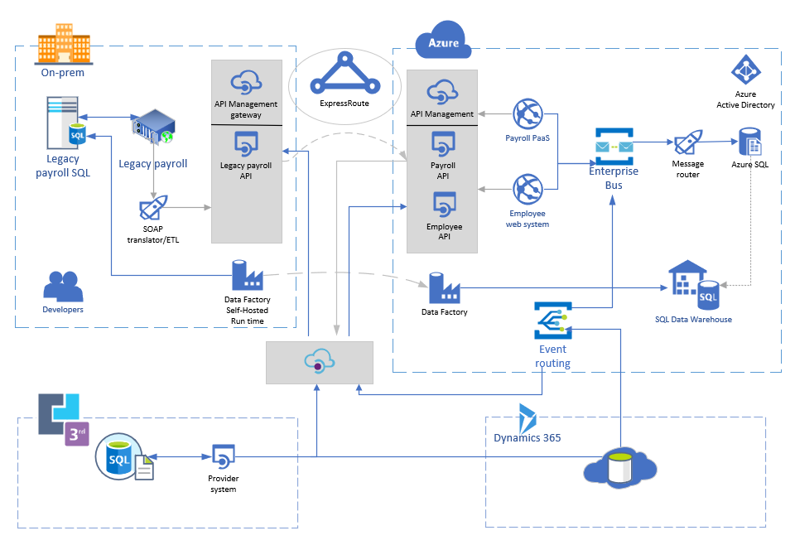
One solution

Slide 28

One tech choice
Logic Apps
Ability to transform SOAP to other (REST)
Hundreds of connectors to connect to/from most sources
Serverless tech, very hands-off

Slide 29
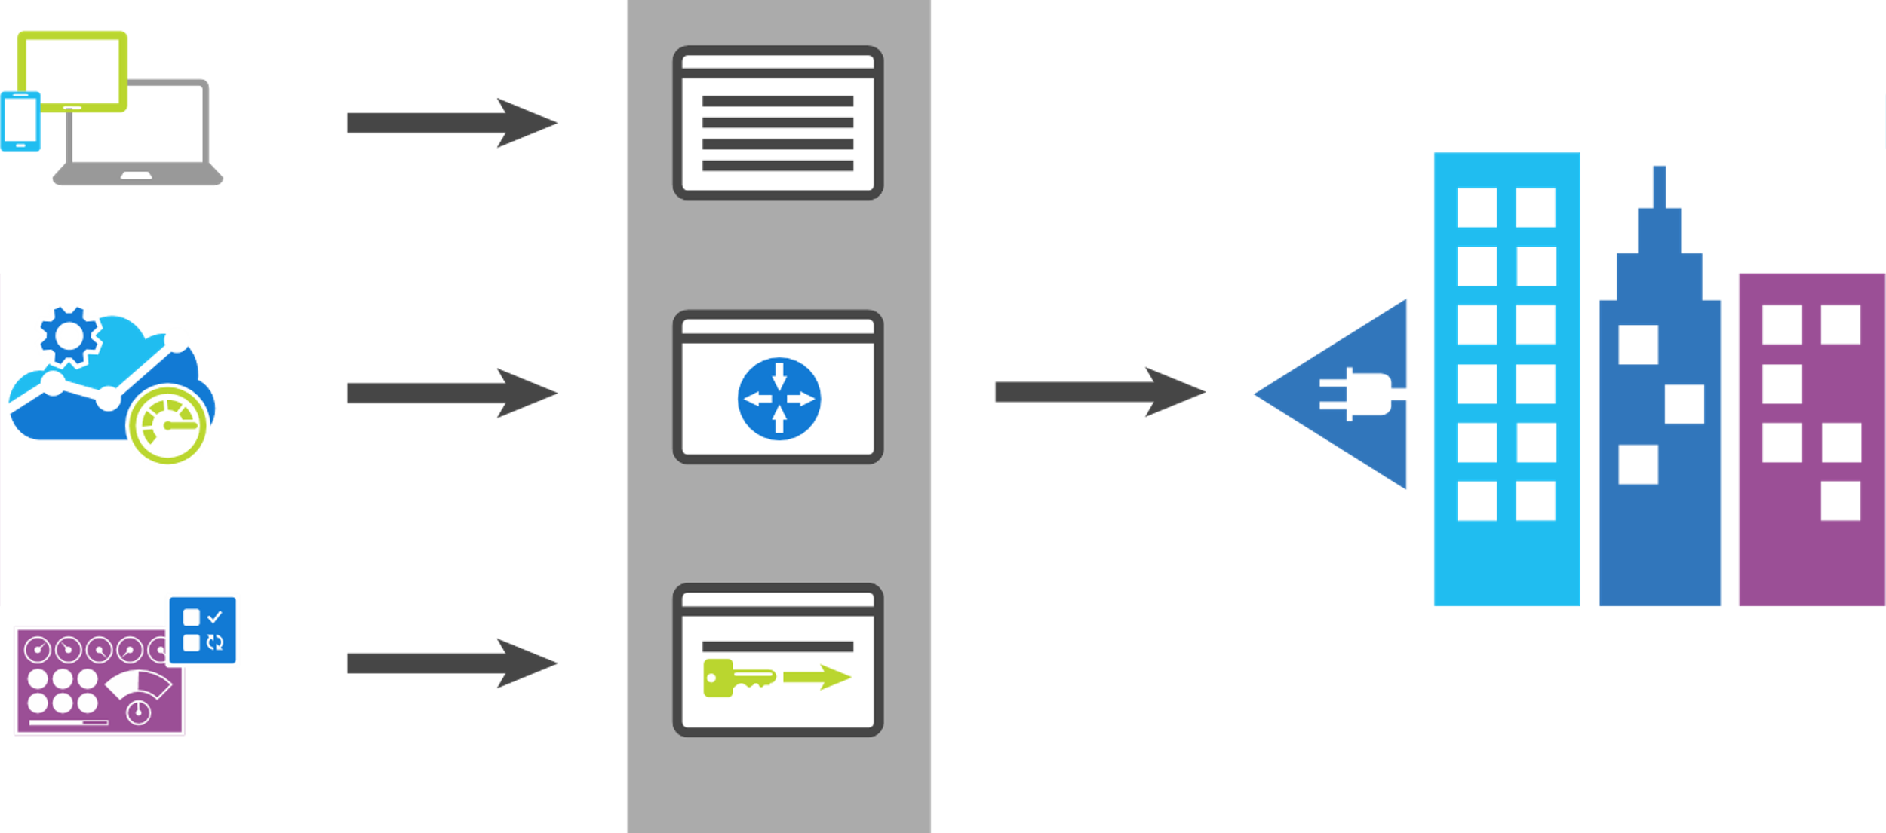
API Management
App developers
Developer portal
Direct to VPN
Apps
Gateway
Backend Services
Apps Publishers
Publisher portal
Notes:
Azure API Management fills all the roles of an API management platform, acting as an API Gateway, a Publisher Portal and a Developer Portal.
The API Gateway is the endpoint that accepts API calls and routes them to your backend services, making the necessary request and response transformations along the way. It’s responsible for enforcing security policies, usage quotas and rate limits, providing optimisations such as caching and for collecting and logging all the metadata on how the APIs are being used for reporting and analysis.
The Publisher Portal is the admin interface where you register and configure your APIs – defining or importing the schemas, packing APIs into products, setting up policies and managing users.
And the Developer Portal acts as the community site for your developers, where they can read API documentation, try out an API via the interactive console, create their account and subscribe to get API keys and access analytics on their own API usage.

Slide 30
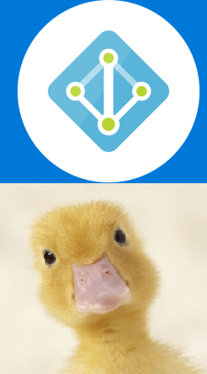
Security
Access control
Use Azure Active Directory
Customize Branding
AAD Reports
Apply to any of the web services

Slide 31
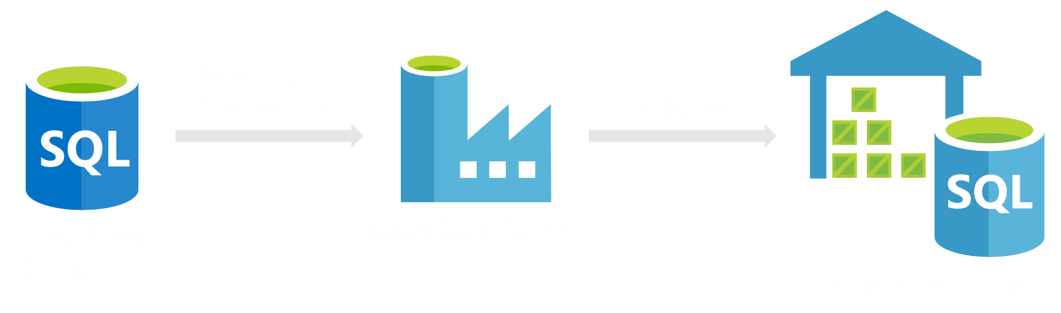
One tech choice
Data Warehouse

Slide 32
Customer quote
“I can sleep better at night knowing that our our kitchen is always stocked with fresh bread, and one of our employee benefits is a pond out the back staff can use when they like. Quack.”
- Quack McJefferson, CIO of Fluffy Ducks co.

Slide 33
Thank you!
Feedback: <email here>
Workshop Content:
aka.ms/mcw-integration-casestudy

